Slide 1
Vintage Machines.

Slide 2
Content
Introduction
Languages used
HTML language
CSS language
Code
HTML code
CSS code
Output
Reference

Slide 3
Introduction
With different categories of older bikes it can be confusing to know what’s classed as a vintage bike
It distinguishes from the other categories, including classic, antique or even future classic. Here’s what you need to know about what constitutes a vintage motorcycle.
vintage motorbike is a motorbike that’s over 30 years old.
vintage bike must’ve been manufactured before 1975 to be considered truly ‘vintage’.

Slide 4

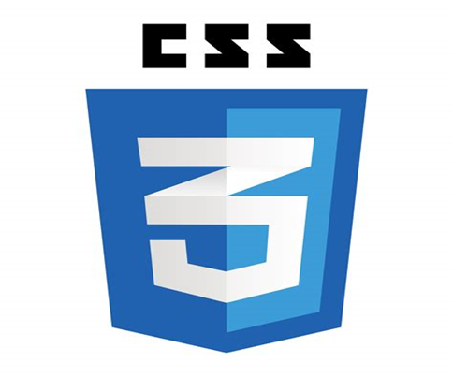
Languages used

Slide 5

About Html Language
HTML stands for Hyper Text Markup Language.
HTML is the standard markup language for creating Web pages.
HTML describes the structure of a Web page.
HTML consists of a series of elements.
HTML elements tell the browser how to display the content.

Slide 6
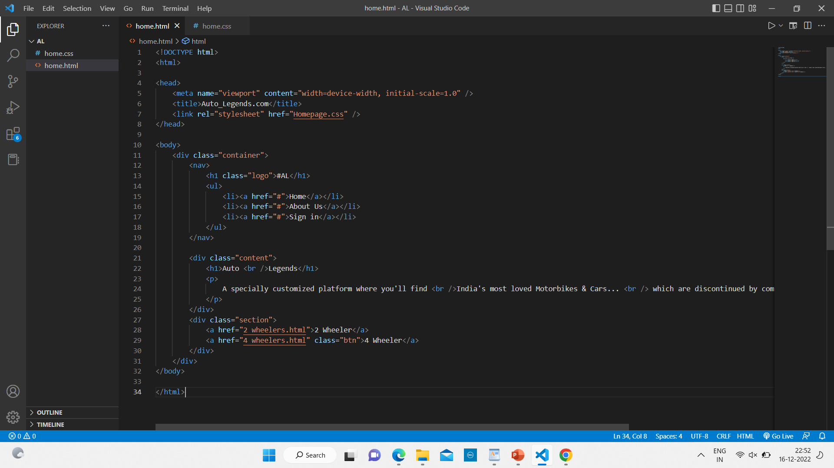
Html code

Slide 7

About CSS Language
CSS stands for Cascading Style Sheets.
CSS, is a simple design language intended to simplify the process of making web pages presentable.
CSS handles the look and feel part of a web page.
Using CSS, you can control the color of the text, the style of fonts, the spacing between paragraphs, how columns are sized and laid out,.
what background images or colors are used, layout designs, variations in display for different devices and screen sizes as well as a variety of other effects.

Slide 8
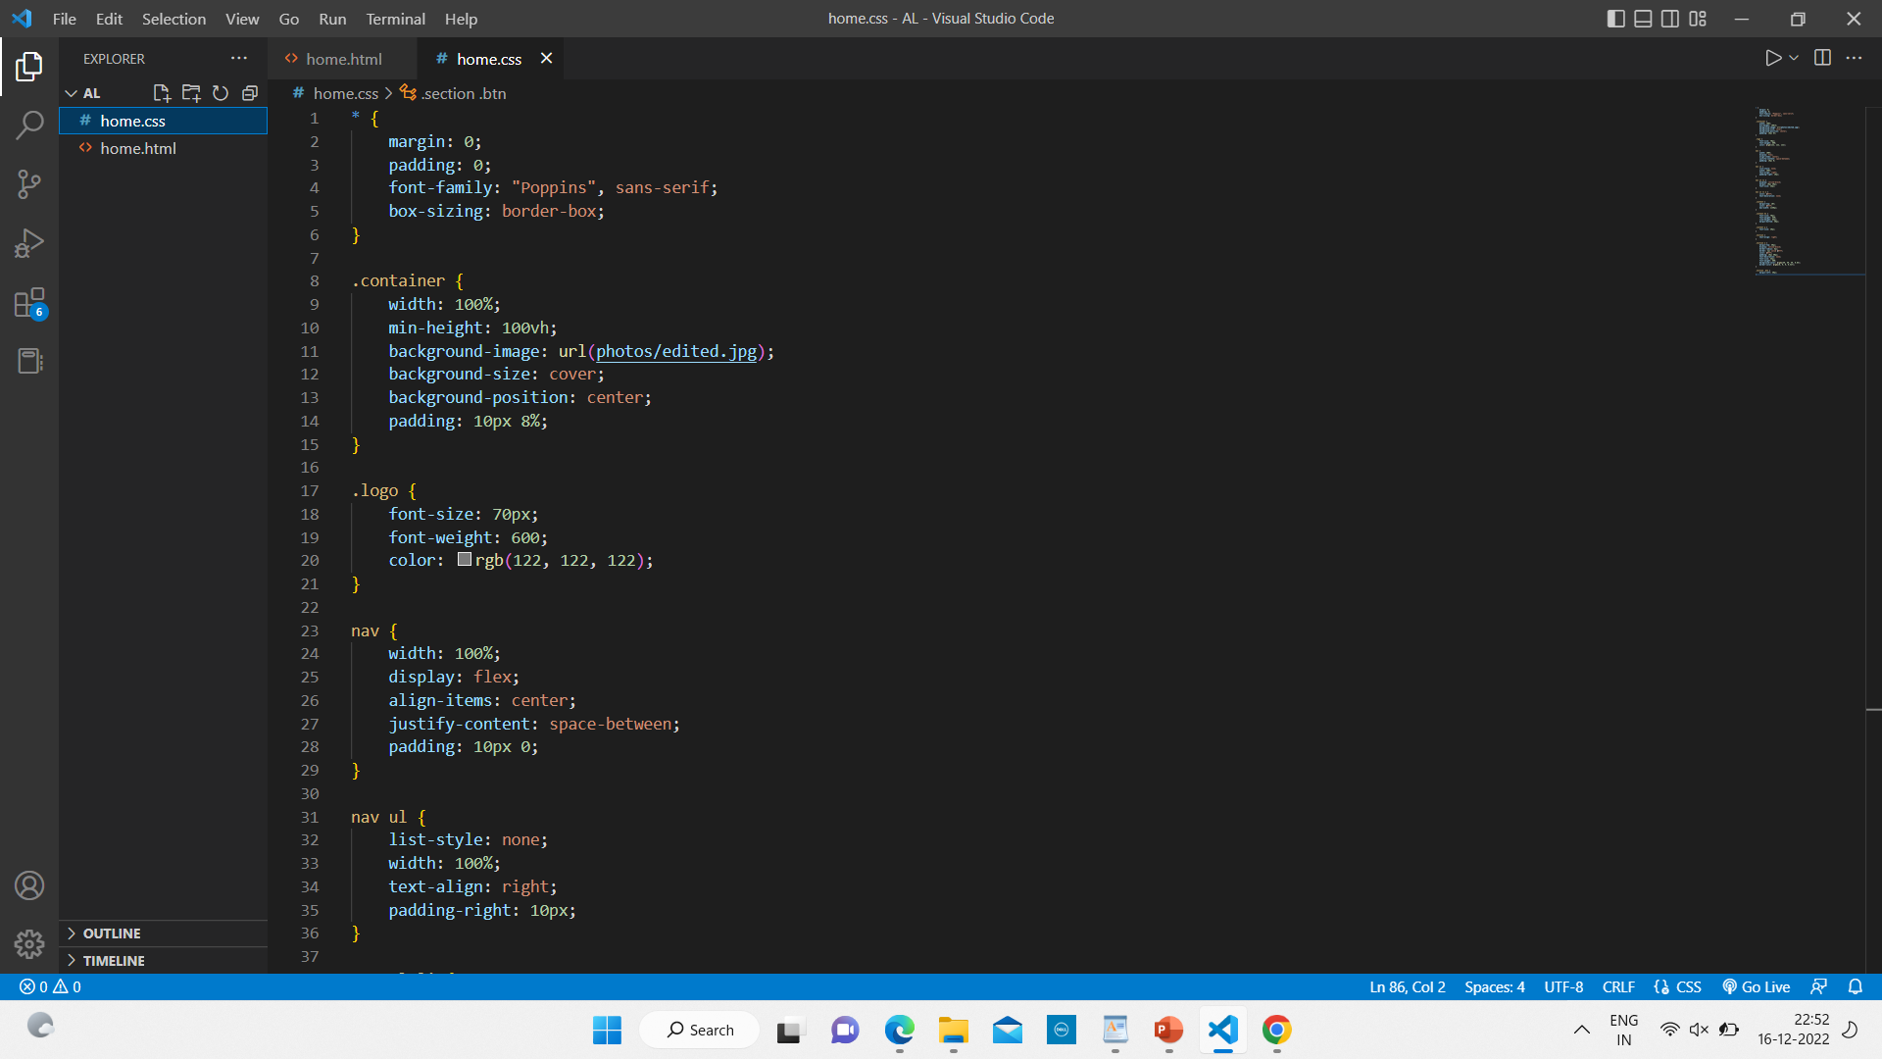
CSS Code

Slide 9
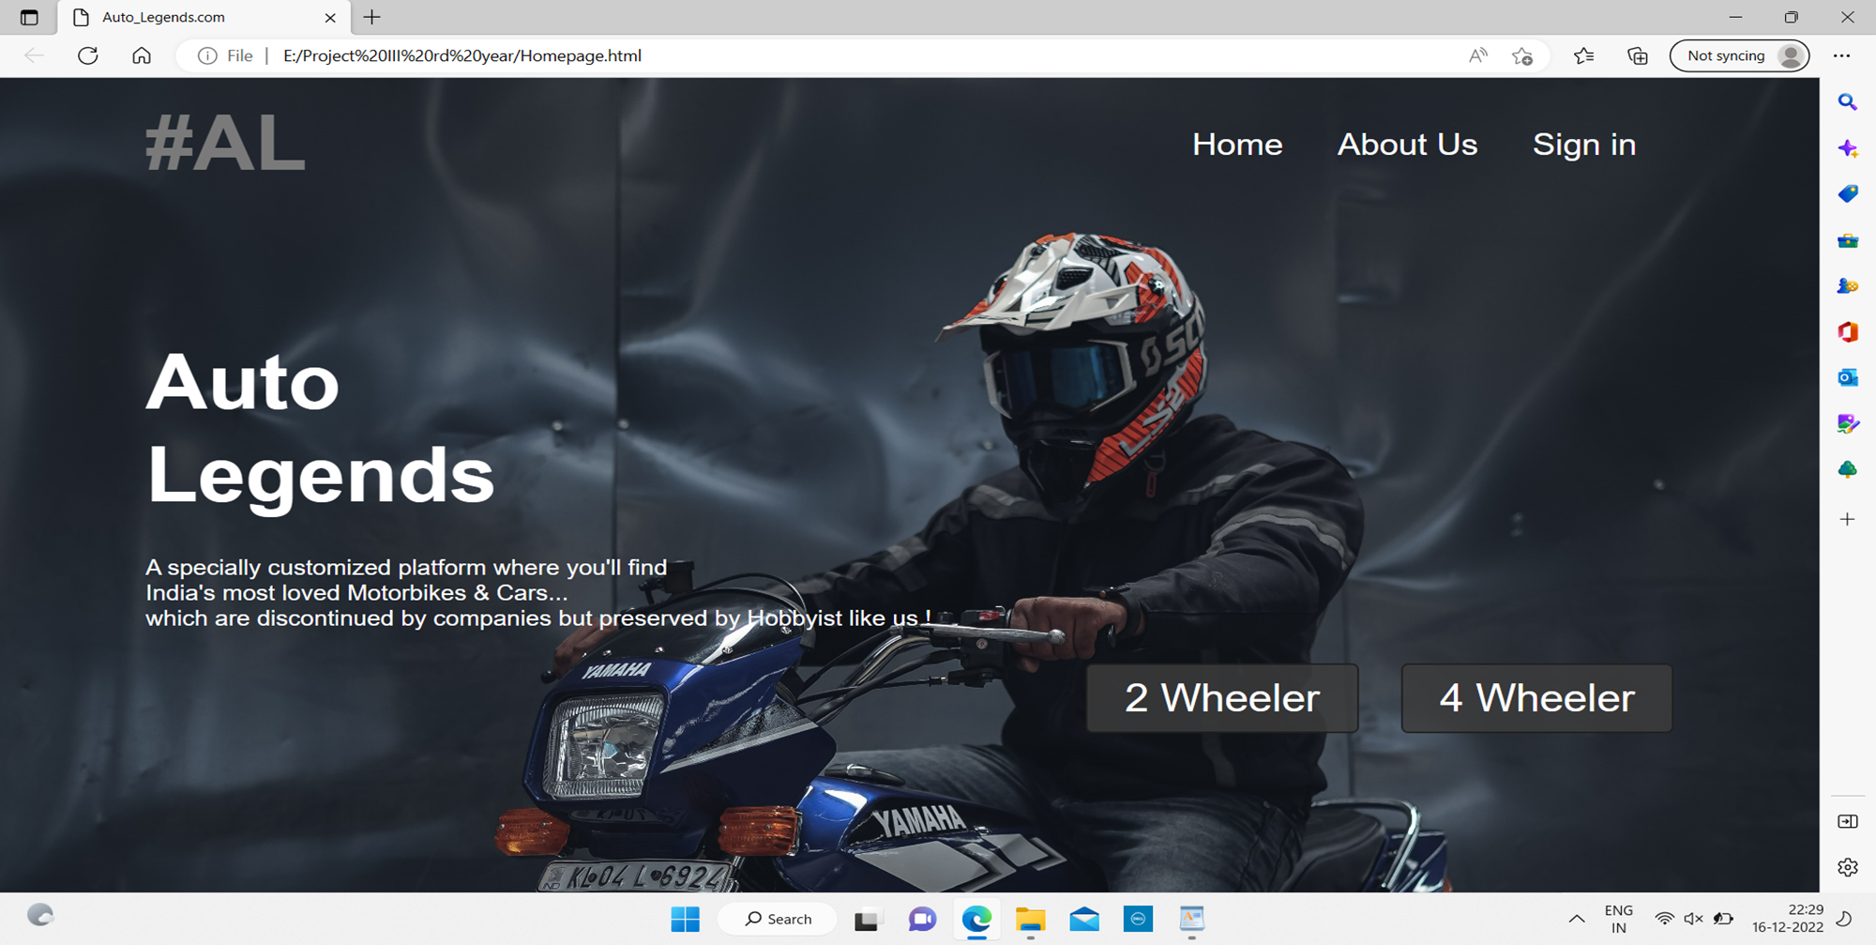
Output

Slide 10
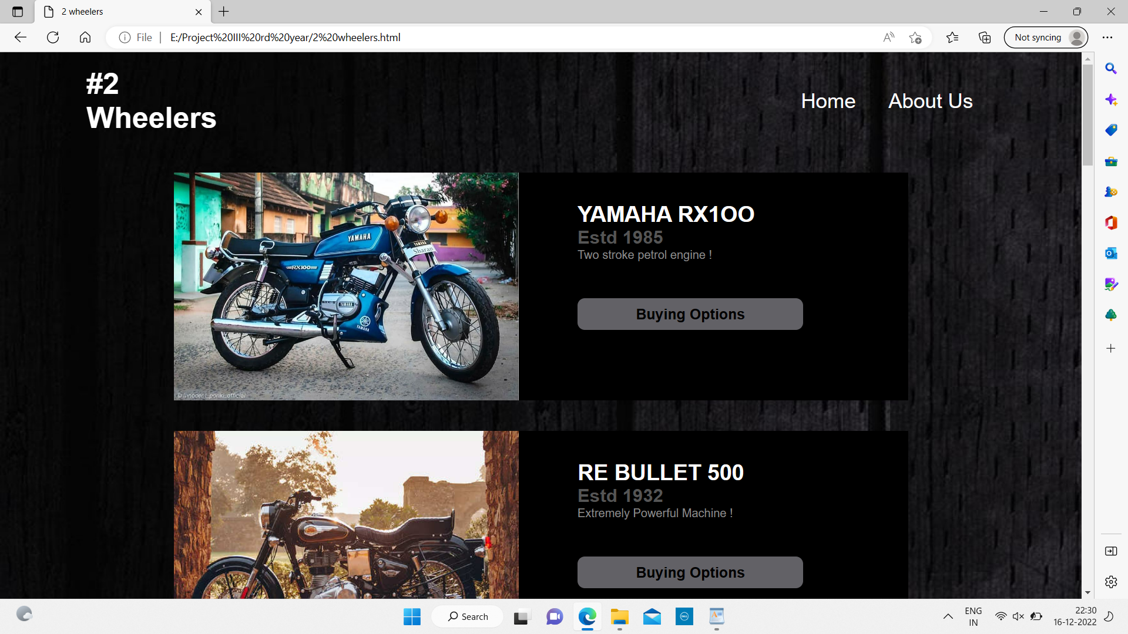

Slide 11
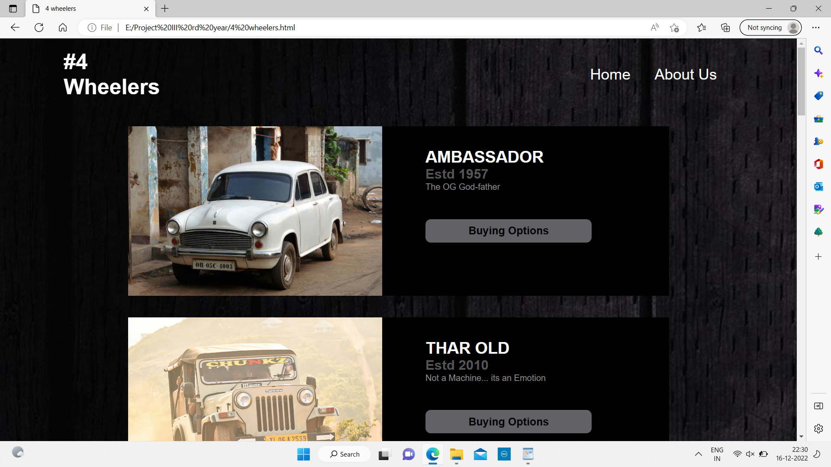

Slide 12
Reference
https://www.w3schools.com/
https://www.olx.in/en-in/items/q-yamaha-rx-100
https://www.olx.in/items/q-bullet-500
https://www.olx.in/en-in/cars_c84/q-ambassador

Slide 13


